Slide 1
Capstone Project
EDA on Play Store App Reviews
By
Omkar Dandvate
Data Science Trainee, AlmaBetter

Slide 2

Problem Statement
Two datasets are provided, one with basic information and the other with user reviews for the respective app.
We must go through dataset to evaluate the data in order to identify the important characteristics that inﬂuence app engagement and success.
So, what factors inﬂuence an app's success?
An app is said to be successful if it has:
A high average user rating
A good number of positive reviews
Type of App and Content rating is made

Slide 3
Data Summary
Play store data
User reviews
App
Translated Review
Sentiment
Sentiment_Polarity
Sentiment_Subjectivity
App
Category
Size
Rating
Reviews
Installs
Type
Price
Content Rating
Genres
Last Updated
Current Ver
Android Ver

Slide 4
Agenda
Correlation heatmap
Content Rating Analysis
Categorical Analysis
App Rating Analysis
Top Free and Paid Apps
Most Popular Apps
App Size Analysis
App Reviews Analysis
Challenges Faced
Analysis Summary

Slide 5
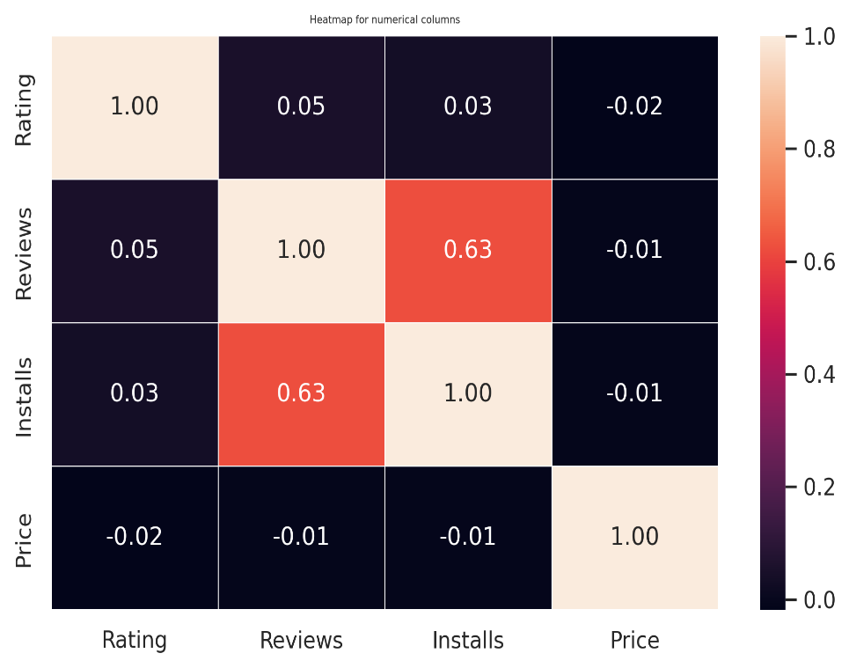
Correlation Heatmap
❏ There is a strong positive correlation between the Reviews and Installs.
❏ The Price is slightly
negatively correlated with
and
the Rating, Reviews, Installs.
❏ The Rating is slightly positively correlated with the Installs and Reviews.

Slide 6
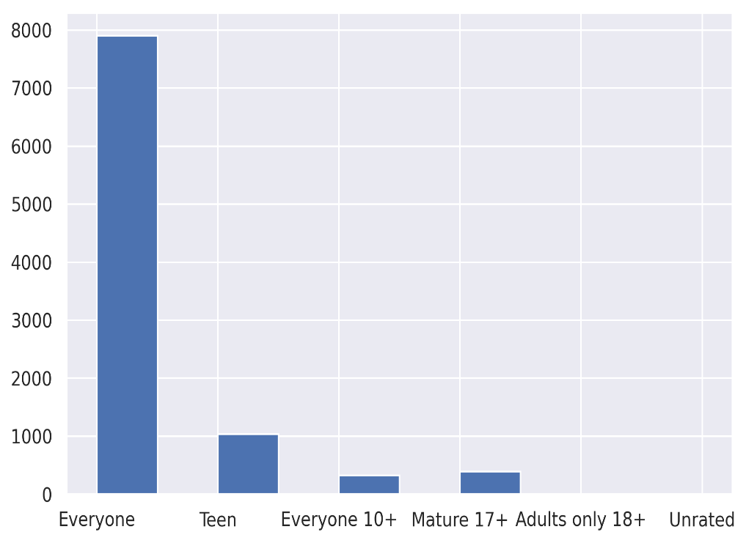
Content Rating
Content rating types in the dataset
We can see that content ratings for every group.
Everyone 7903
Teen 1036
Mature17+ 393
Everyone10+ 322
Adults only18+ 3
Unrated 2

Slide 7
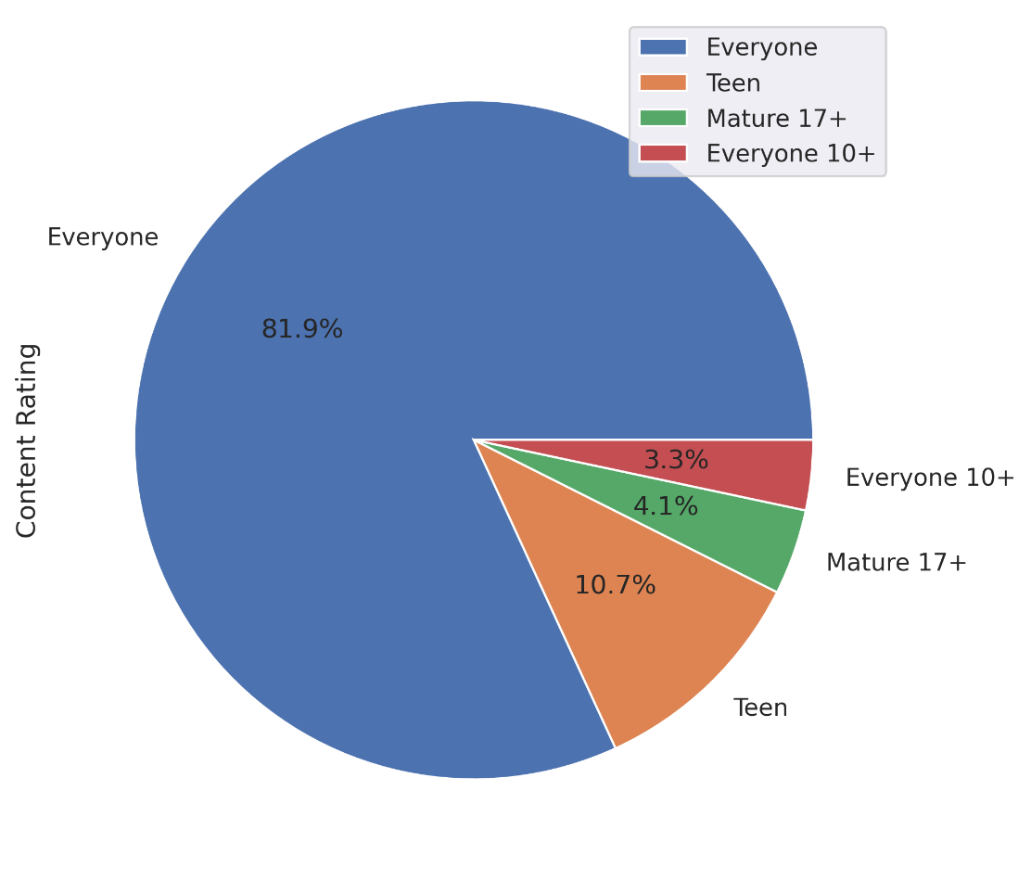
As value for below 2 category only18+ 3 Unrated 2 are very less, For good output it can be ignored
We can clearly see majority of apps can be used by everyone.

Slide 8
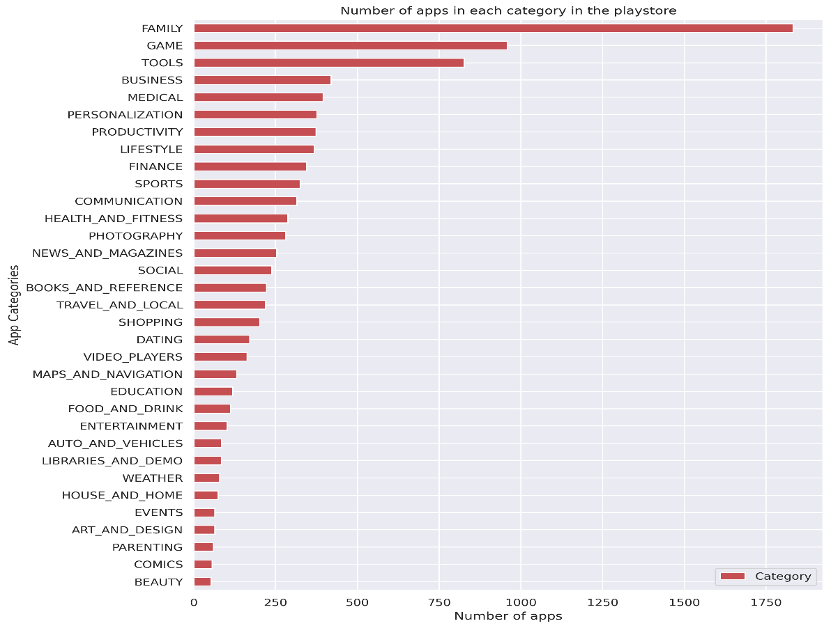
Categorical Analysis
Category vs No. of Apps
From the plot, it is evident that Family, Game, and Tools category have the maximum number of apps compared to other categories.

Slide 9
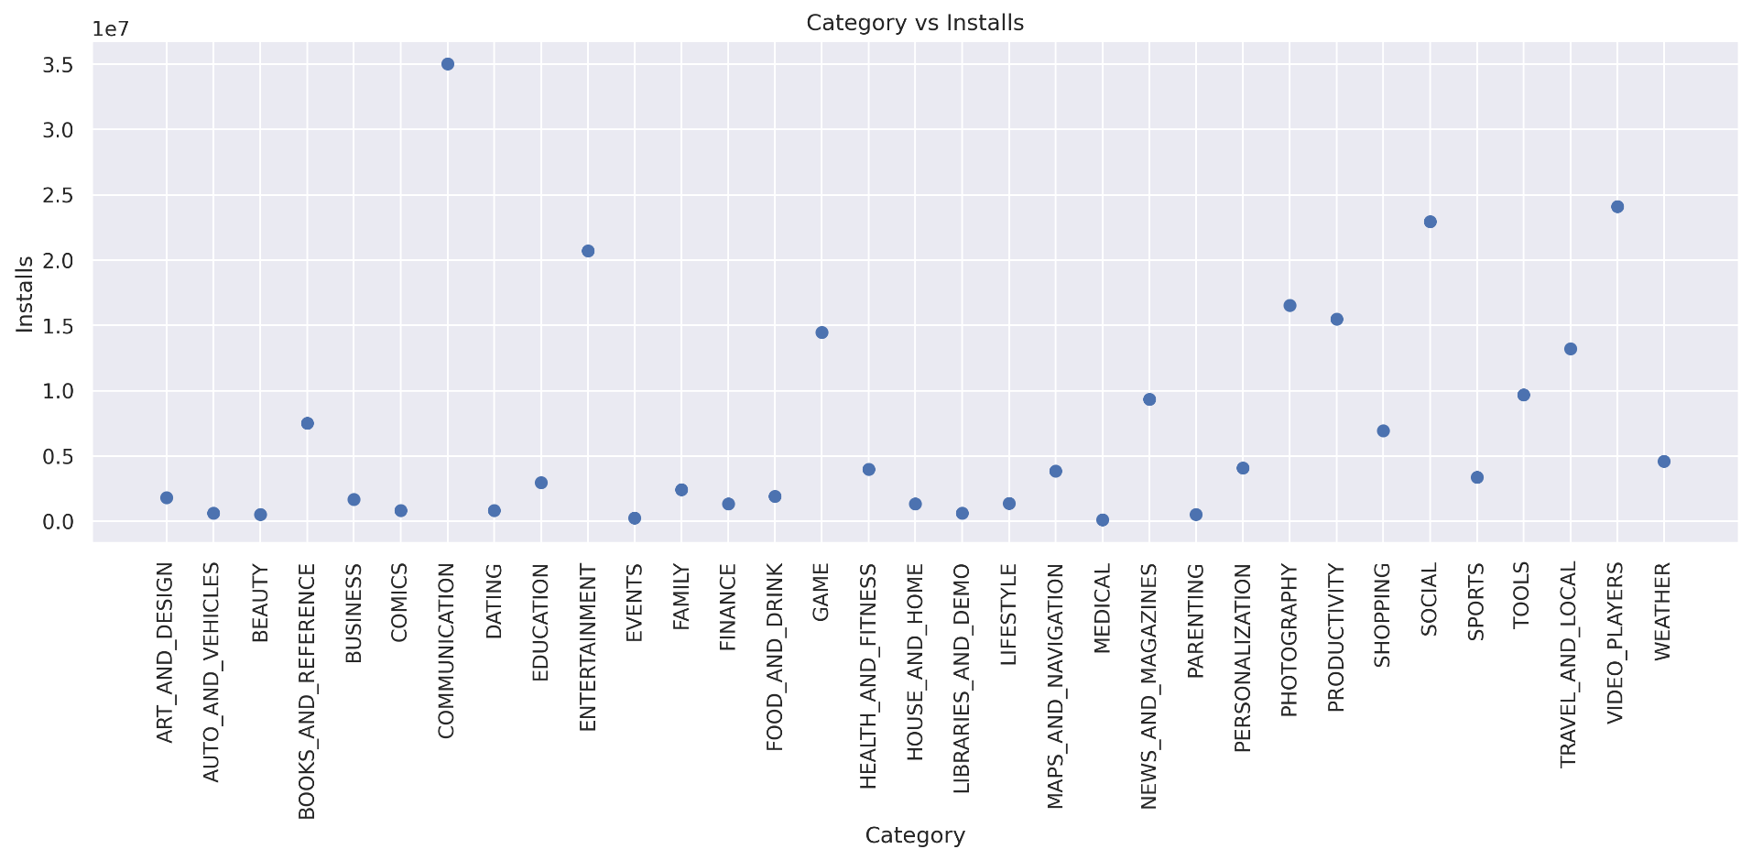
The Communication, Video Players, and Social category has the highest number of average app installs.

Slide 10
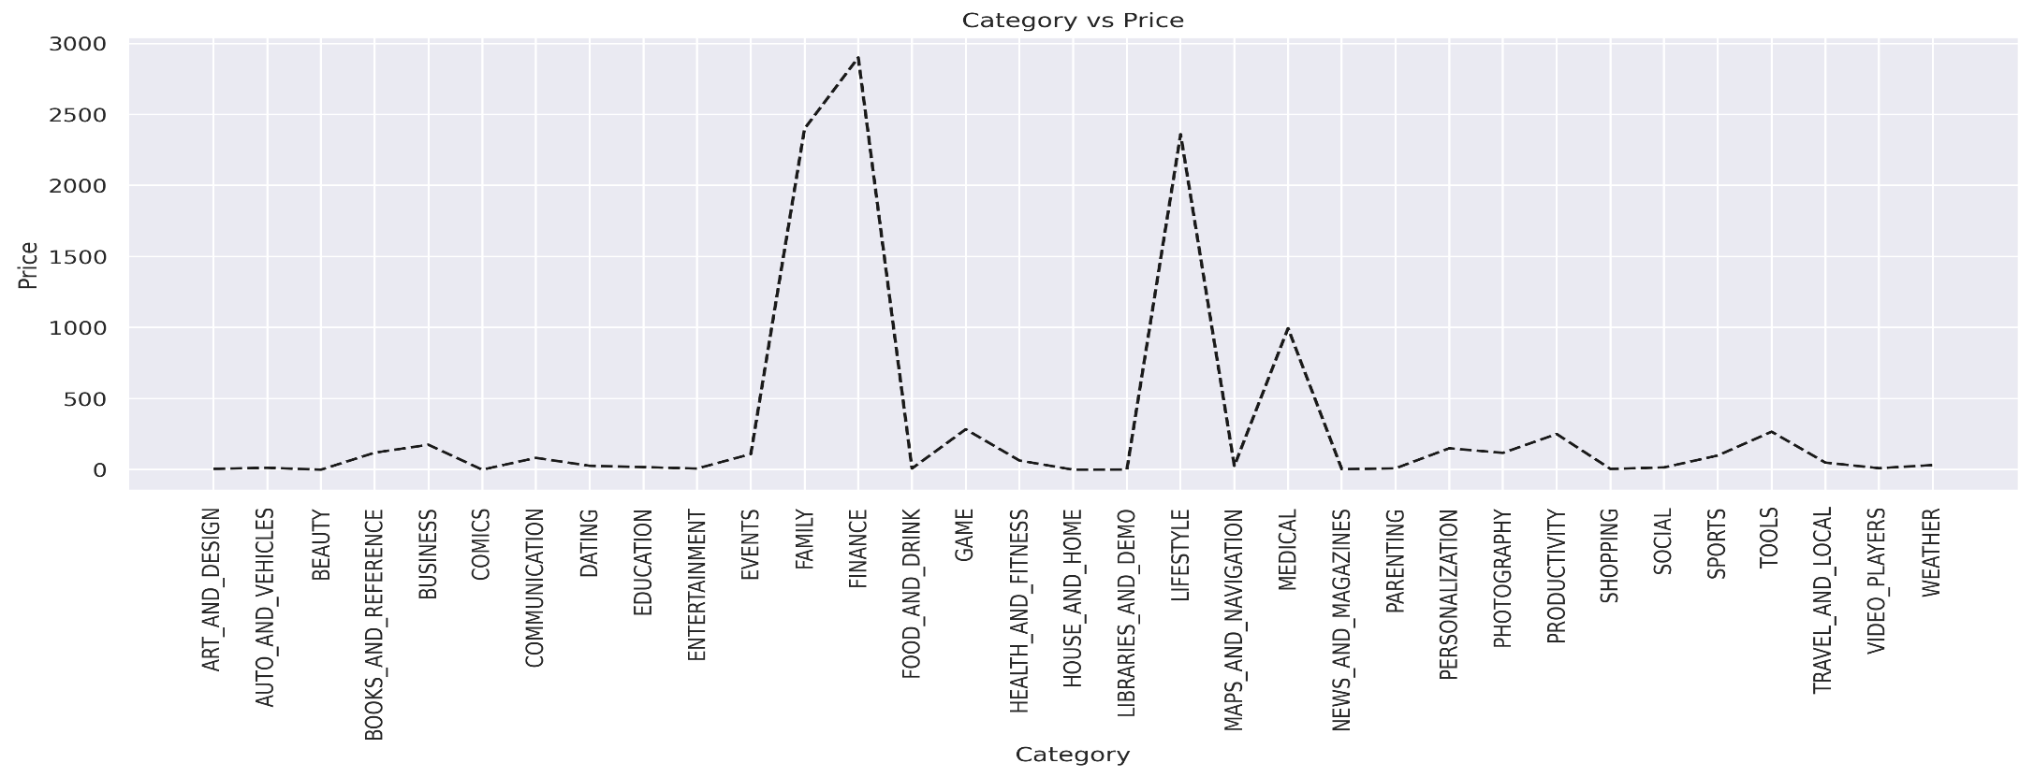
From the plot, it is seen that Finance , Family, and Lifestyle category have the maximum number of paid apps compared to other categories.

Slide 11
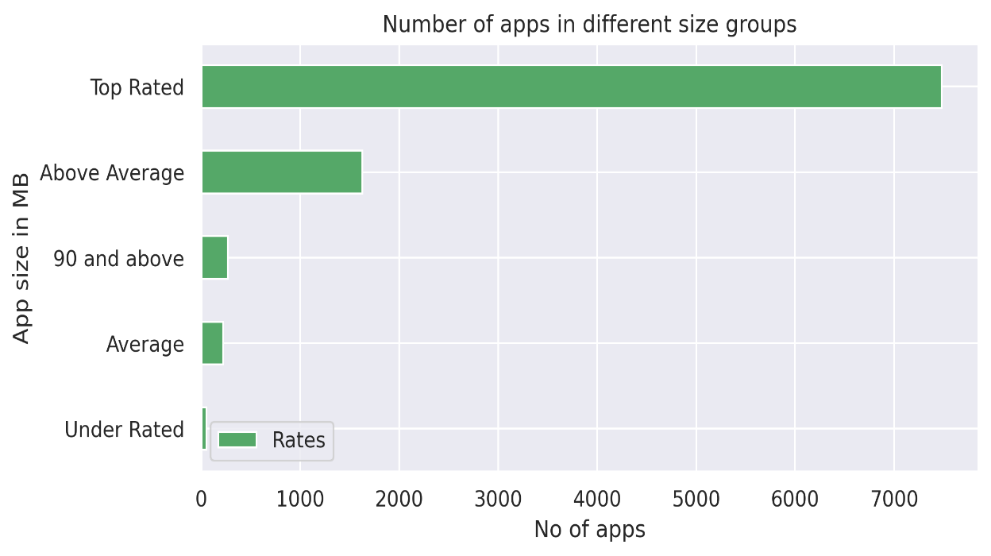
App Rating Analysis
The average user rating is divided into 4 categories:
Rating: 4- 5 ⇒ Top Rated
Rating: 3- 4 ⇒ Above Average
Rating: 2- 3 ⇒ Average
Rating: 1- 2 ⇒ Below Average
The majority of the apps in the Play Store (approx 80 %) are top rated.

Slide 12
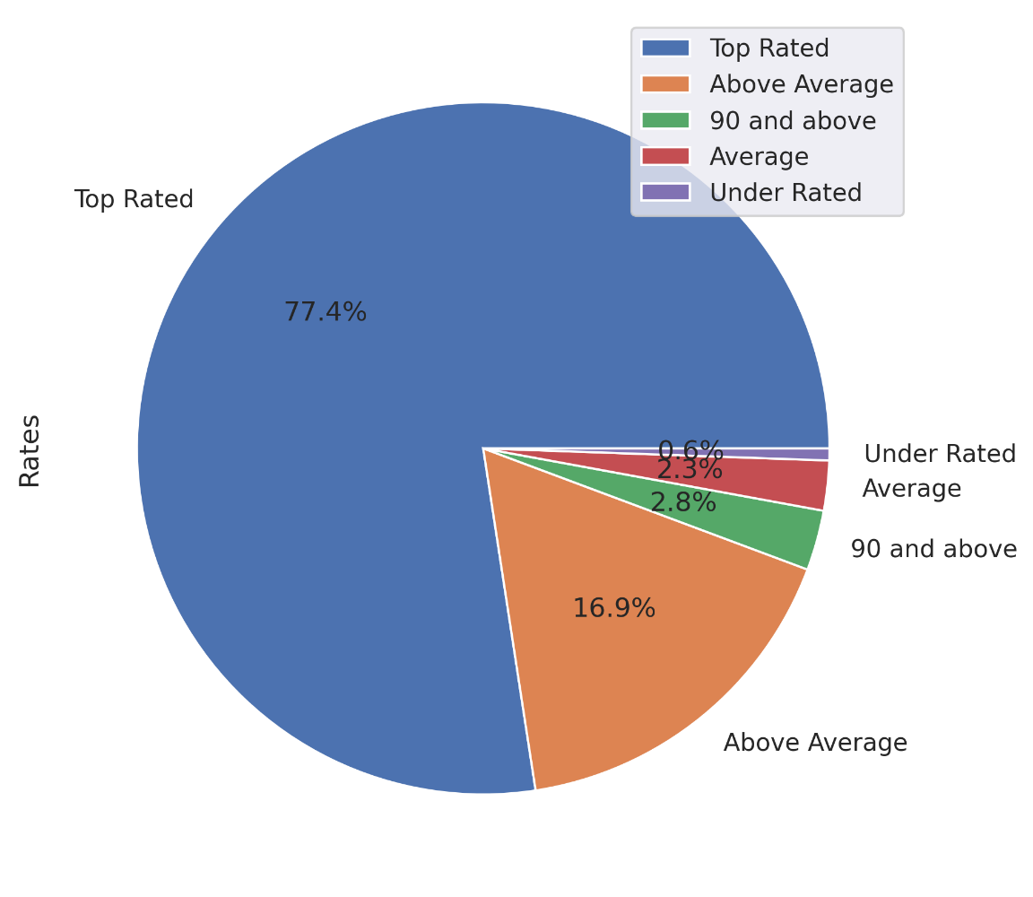
It is seen that most of the apps from Google play store are Top Rated and customers are happy with App services

Slide 13
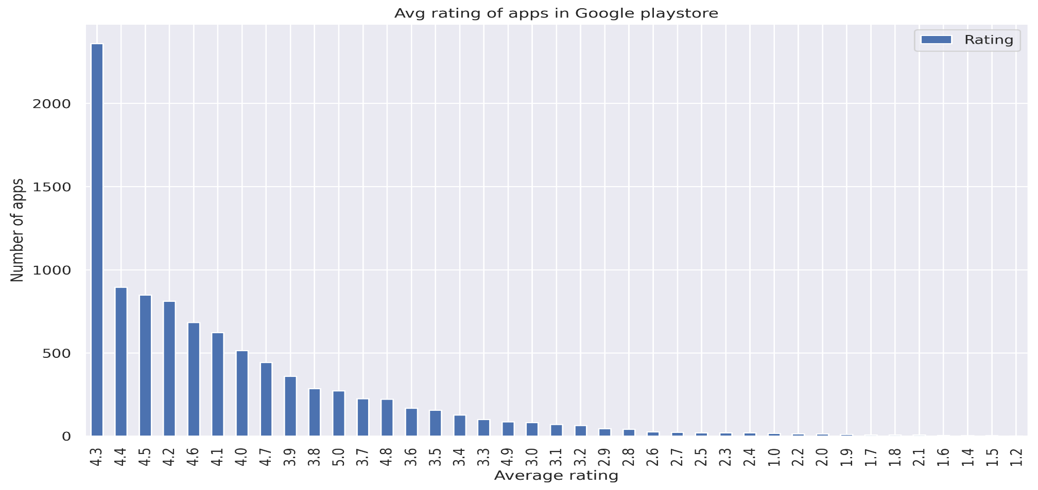
Most of the app in playstore are rated 4.3 which is on higher side.

Slide 14
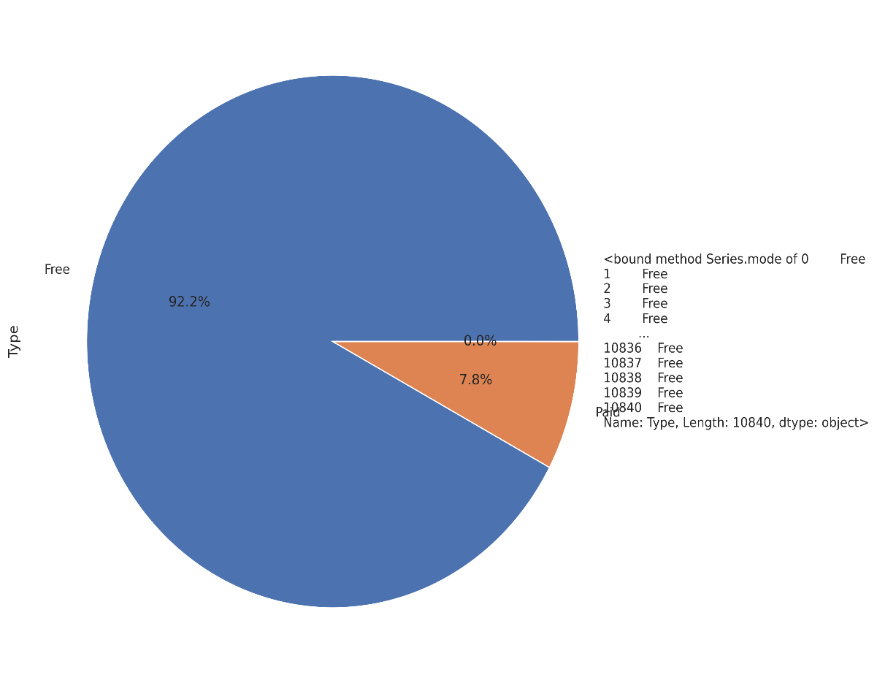

Apps types
There are total more than 90% apps in play store are free
Very less % of apps are paid category

Slide 15
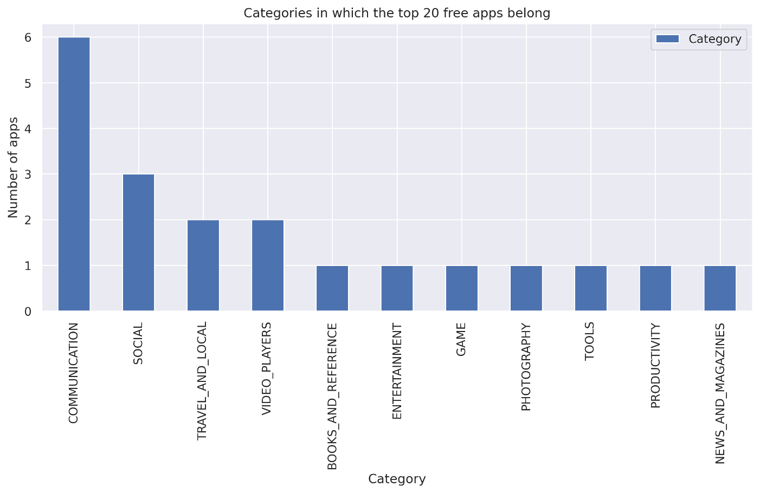
Most of Free app belongs to category as follows,
1.Communication
2. Social
Few top free apps are :
335 Messenger – Text and Video Chat for Free
336 WhatsApp Messenger
338 Google Chrome: Fast & Secure
340 Gmail
341 Hangouts
391 Skype - free IM & video calls
865 Google Play Games
1654 Subway Surfers
2544 Facebook
2545 Instagram
2554 Google+ 2808 Google Photos 3117

Slide 16
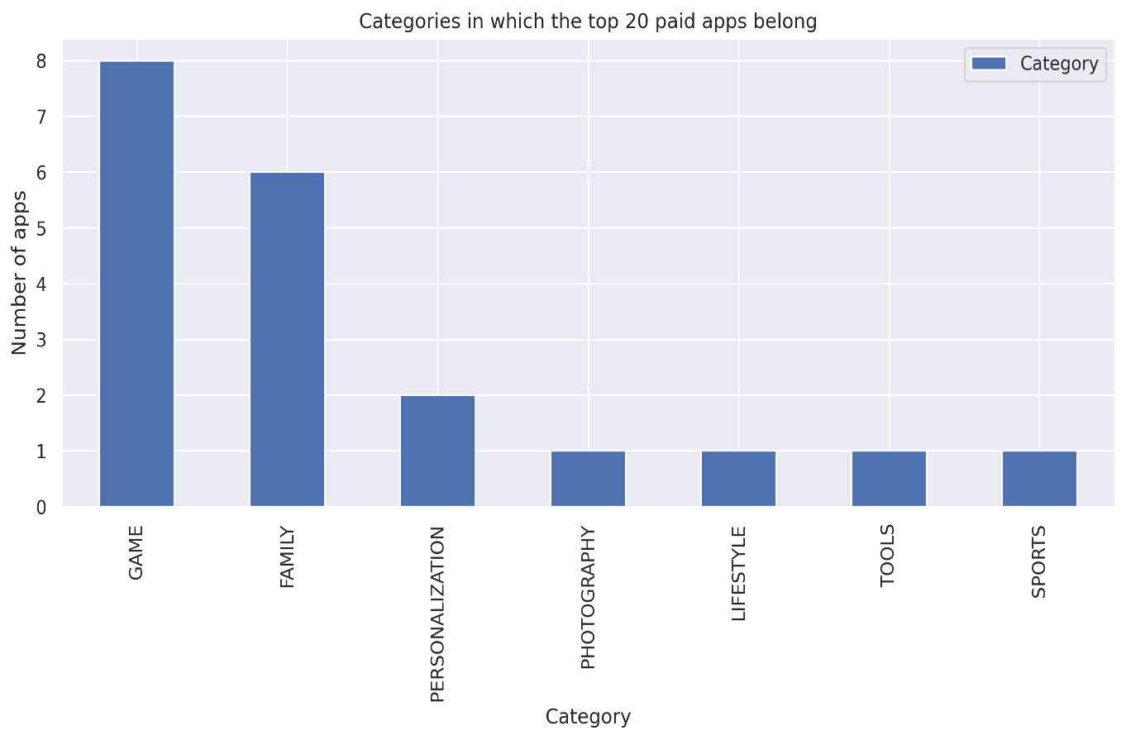
Most of Free app belongs to category as follows,
1. Games
2. Family
Few top paid apps with highest no of downloads are :
Hitman Sniper - Game
Minecraft - Family

Slide 17
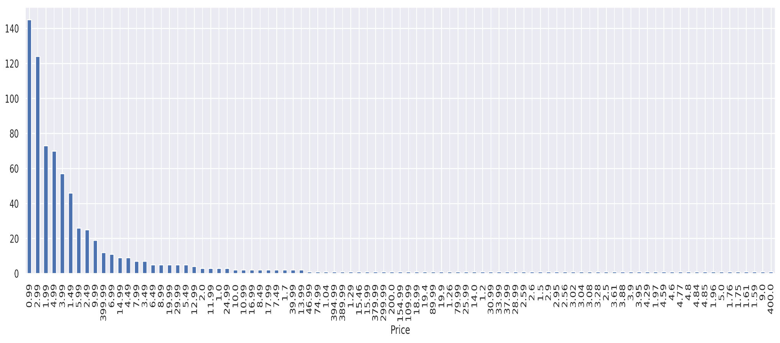
no of apps that can be installed at a particular price
Most paid app are less than 1 $

Slide 18
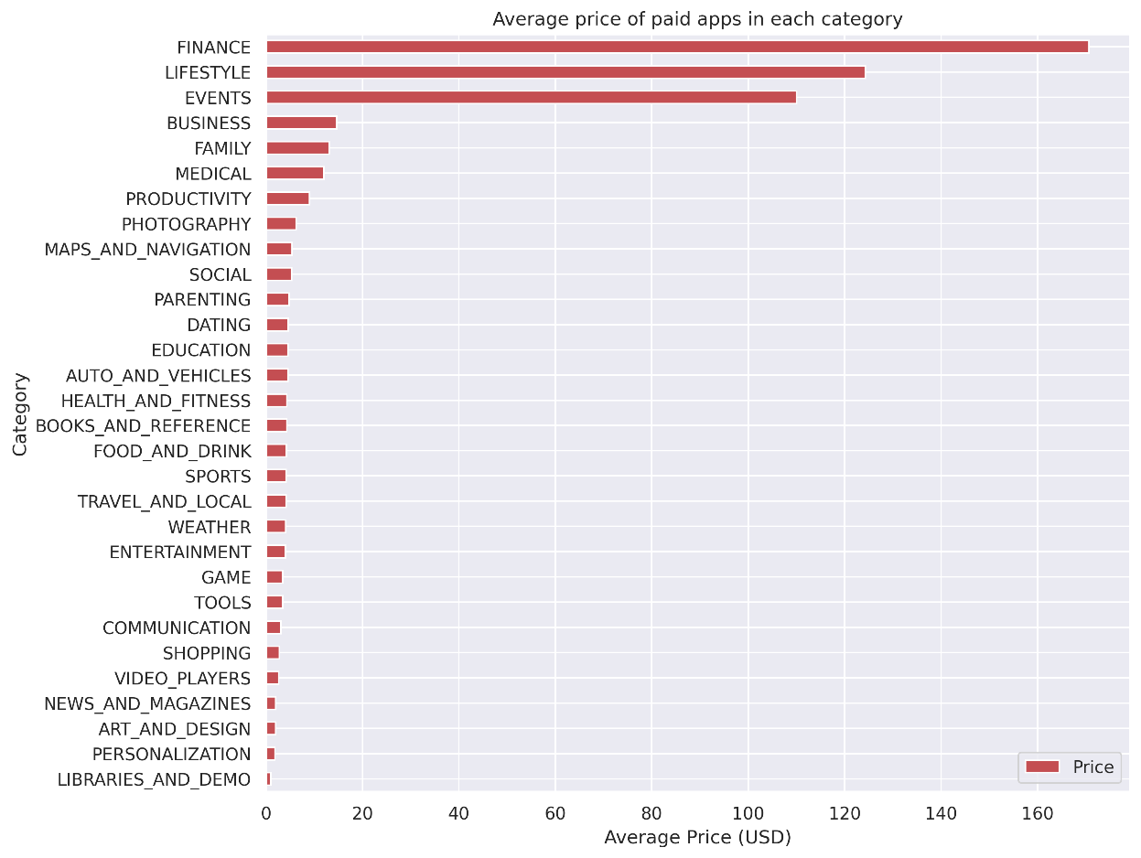
Average price of paid apps in
each category
It can be seen that apps in Finance , Lifestyle , Style are costly.

Slide 19
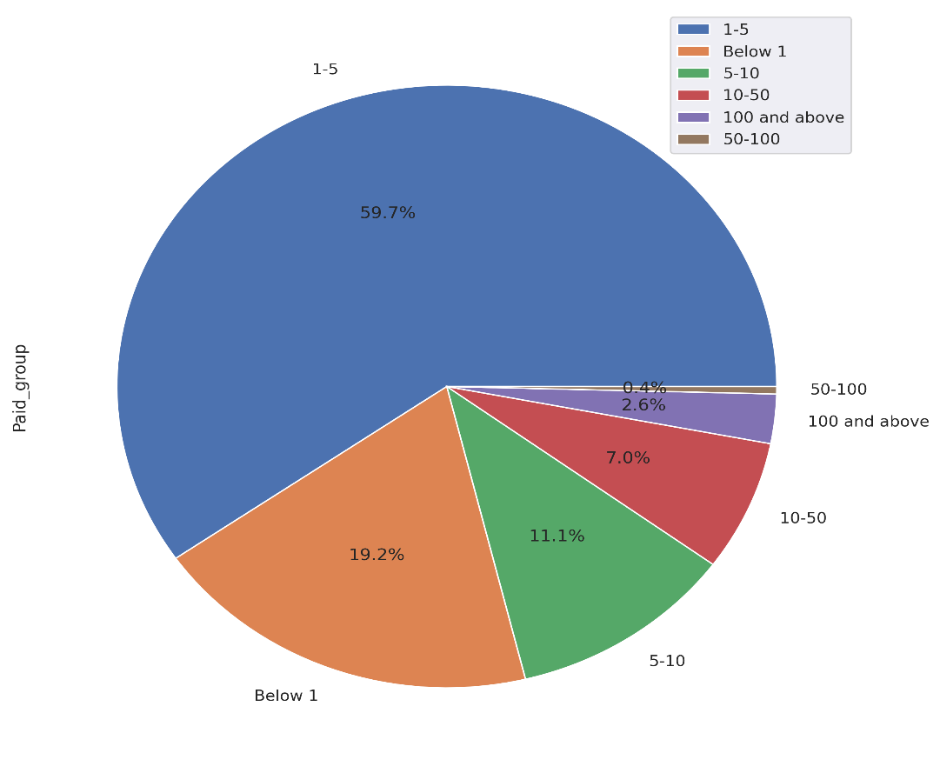
Paid App Analysis
The paid app are divided into categories:
1-5 451
Below 1 145
5-10 84
10-50 53
50-100 3
100 and above 20
The majority of the paid apps in the Play Store has fees between 1 $ to 5 $.

Slide 20
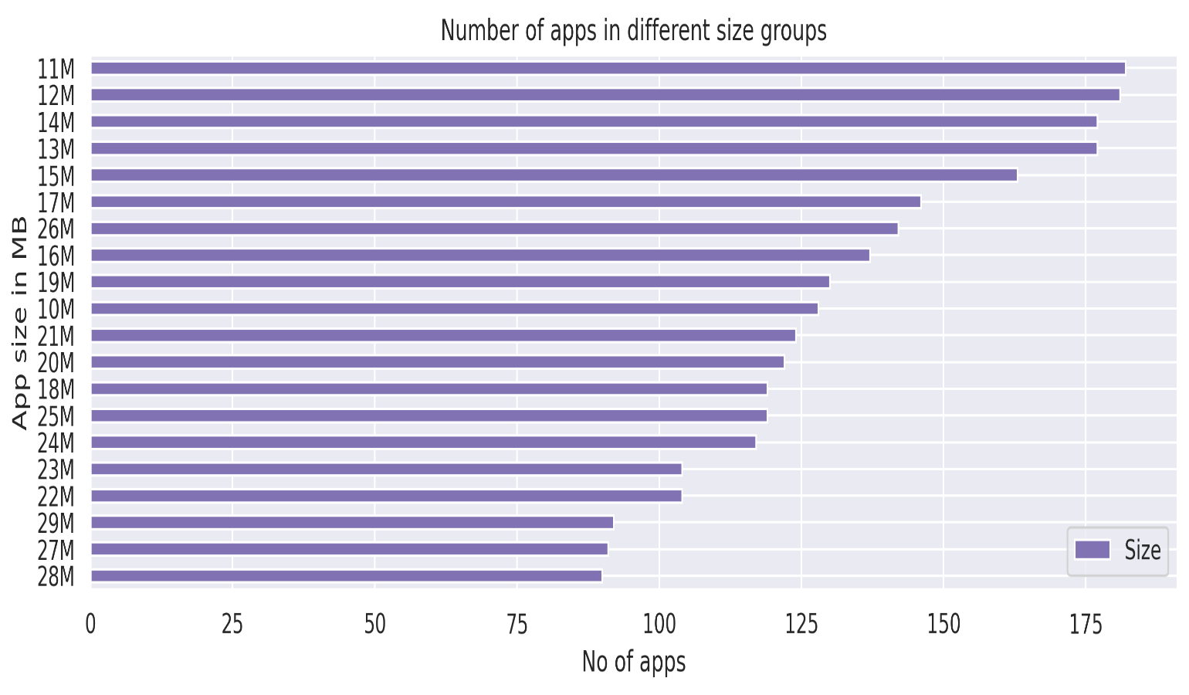
Analysis on bases of SIZE of App in Play store.
Varies with device 1226 11M 182
12M 181
14M 177
13M 177
It can be concluded that
If excluded “Varies with device ” values, most of the apps in play store are of size between 11 M to 15M.

Slide 21
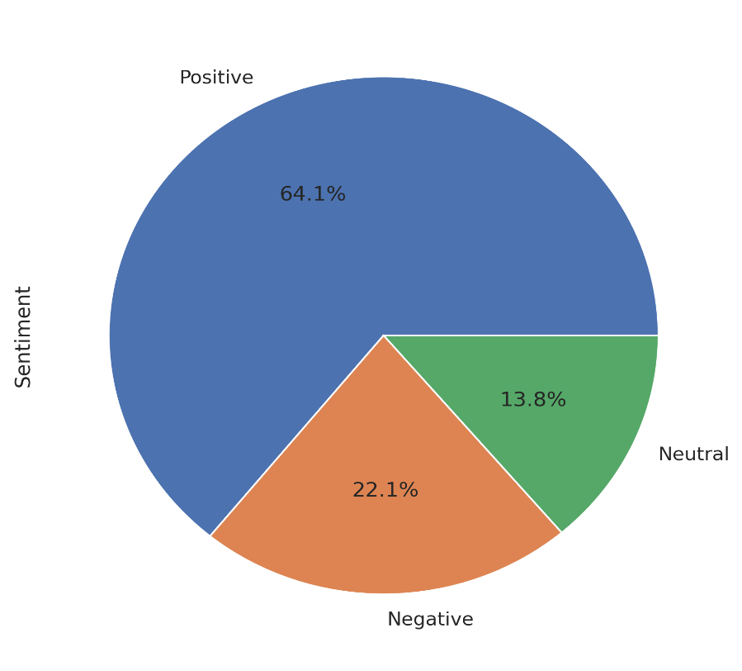
App reviews
We can state that the apps has below reviews whether positive, negative, or neutral.
Most of the app has received positive reviews.

Slide 22
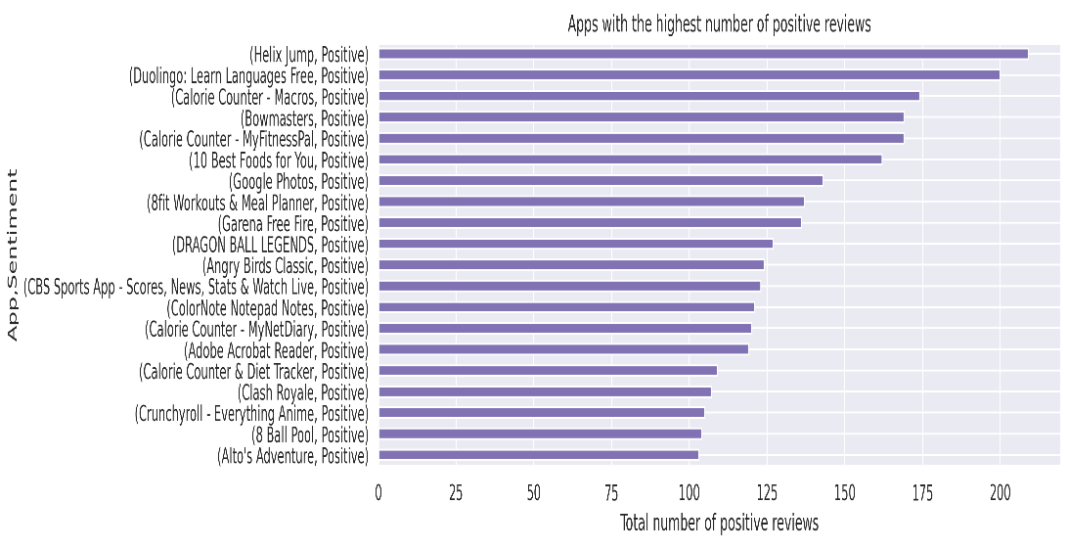
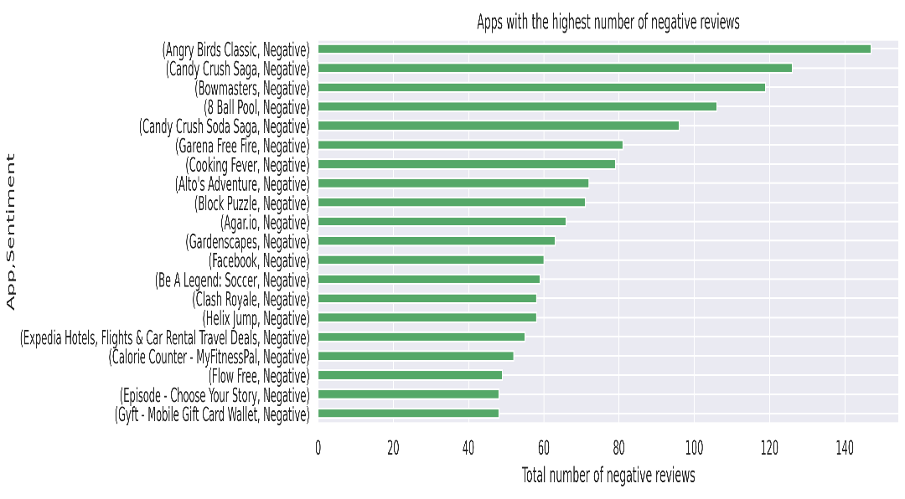
Positive and Negative Reviews
It is clear that Angry Birds Classic has got highest negative reviews
It can be seen that Helix Jump has got the highest positive reviews.

Slide 23

Challenges Faced
Reading the dataset and comprehending the problem statement.
Handling the error, duplicate and NaN values in the dataset.
Designing multiple visualizations to summarize the information in the dataset and successfully communicate the results and trends to the reader.

Slide 24
Analysis Summary
There is a strong positive correlation between the Reviews and Installs.
We can clearly see majority of apps can be used by everyone
From the plot, it is evident that Family, Game, and Tools category have the maximum number of apps compared to other categories.
The Communication, Video Players, and Social category has the highest number of average app installs
From the plot, it is seen that Finance , Family, and Lifestyle category have the maximum number of paid apps compared to other categories.

Slide 25
The majority of the apps in the Play Store (approx 80 %) are top rated.
It is seen that most of the apps from Google play store are Top Rated and customers are happy with App services
Most of the app in playstore are rated 4.3 which is on higher side.
There are total more than 90% apps in play store are free.
Most of Free app belongs to category as follows,
1.Communication
2. Social
Most of Free app belongs to category as follows,
1. Games
2. Family
Highest positive reviews - Helix Jump
Highest negative reviews - Angry Birds

Slide 26
It can be seen that apps in Finance , Lifestyle , Style are costly.
The majority of the paid apps in the Play Store has fees between 1 $ to 5 $.
It can be concluded that If excluded “Varies with device ” values, most of the apps in play store are of size between 11 M to 15M.
Most of the app has received positive reviews.

Slide 27


Thank You

